Slide 1
Preliminary Design Review
Team 10
Carlos Jones, Aiden Deady, Manas Pise
RBE 3002 D24

Slide 2
Functionality (Overall)
Phase 1:
Navigate through unknown maze, mapping the space
Use heuristic costs between frontier points
Stop navigating after entirety of map is discovered
Phase 2:
Navigate back to starting point from the current location
Phase 3:
Use AMCL to self-localize location on map from Phase 1.
Navigate to given set of coordinates after localizing

Slide 3
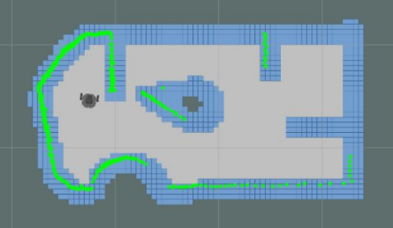
Functionality (Phase 1)
GMapping:
Detect the walls and obstacles as OccupancyGrid
Pass the generate map in order to calculate C Space
Identifying Frontiers:
Centroid of open space at edge of known space
Heuristic
Distance from current location to frontier
Chooses lowest cost that is first in queue
If robot is stuck:
Returns to most recent known location
Spins until unstuck

Slide 4
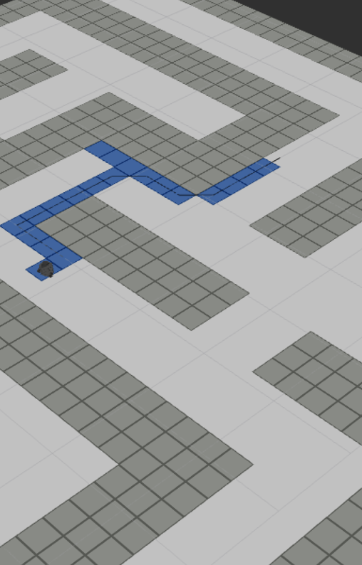
Functionality (Phase 2)
Path Planning:
Buffer C Space to avoid walls
Path does not have to be optimal, just mostly efficient
Given starting location and goal location:
Move through map to reach goal

Slide 5
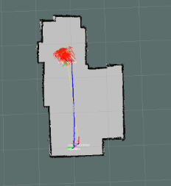
Functionality (Phase 3)
AMCL:
Uses map from Phase 1
Laser scans to localize robot location relevant to map
Identifying Location:
Robot does 360 at start to understand starting location and orientation
If robot is still not localized:
Follow a wall or drive to unobstructed point
Able to gather more data of area surrounding location

Slide 6
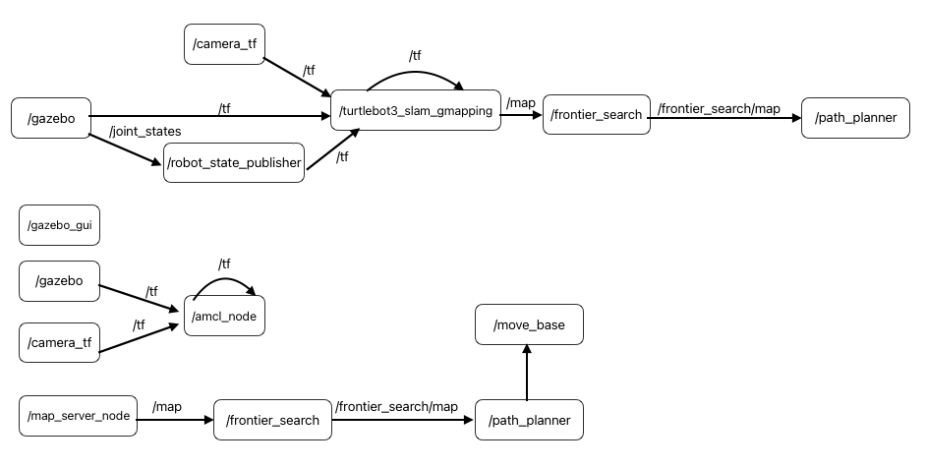
Architecture

Slide 7
Risks and Challenges
Potential slippage or error:
Slower robot speed results in less potential for error
C Space buffer will provide more room for potential error
Re-localization once robot reaches a frontier should reset error build up
LIDAR interference or inconsistency:
There is more room for error with slight inaccuracies in readings. Overall path and movement can still be efficient.
This should not be a major issue.

